Slide 1
Distributed Algorithms 2018/19 Consensus and Related Problems
Danh Le-Phuoc | Open Distributed Systems
With material from R. Karnapke @ KBS

Slide 2
Consensus and Related Problems
Byzantine generals
One value is proposed by one distinguished process
All correct processes agree on the same value (IC1)
If the proposing process is fault-free, the proposed value is the value agreed on (IC2)
Interactive consistency
One value is given by each process
All correct processes agree on the same value vector
The proposed values of fault-free processes are rendered correctly in the value vector
Consensus
One value is given by each process
All correct processes agree on the same value
If all correct processes propose the same value, they all agree on that value

Slide 3
Agreement vs. Consensus vs. Consistency
The three problems can be transferred into each other!
See also Coulouris, pages 452-455
Byzantine Generals
Distribution of the
initial value to all
Each node starts instance
of algorithm
Calculation from
common vector
Consensus
Interactive
Consistency

Slide 4
Byzantine Generals → Interactive Consistency
Solution for Byzantine generals exists, we are searching for a solution for interactive consistency
Each node starts an instance of the algorithm for the Byzantine generals with its value
Each fault-free node takes the value that it calculates as solution for the byzantine generals with process P_{i} as leader as i-th component of its result vector
The result vectors of the nodes are a correct solution of the problem of interactive consistency

Slide 5
Interactive Consistency → Consensus
Solution for interactive consistency exists, we are searching for consensus
The nodes determine a solution for the interactive consistency
Each node gives the value it would also propose for the consensus
Then, each node determines a value from its result vector by means of the majority function; if no majority exists, it takes the default-value
The solution built by the values of the nodes is a correct solution of the consensus problem

Slide 6
Consensus → Byzantine Generals
Solution for consensus exists; we are searching for one for the byzantine generals
The initial value is distributed by the leader to all lieutenants and to itself
Then, a solution of the consensus problem is determined among all generals
Each lieutenant has a consensus value afterwards
The consensus values of all lieutenants form a correct solution of the problem of the byzantine generals

Slide 7
Byzantine Generals
Commander
Traitor
Lamport, Shostak, and Pease, 1982
n > 3 generals, m of them are traitors (cause byzantine faults)
One of the generals is the commander (commanding general) and proposes a value v ∈ {0, 1}
The other generals (lieutenant generals) shall execute the order of the commander
At least 1 lieutenant is loyal (fault free)
Even the commander can be a traitor (faulty)
Question: Attack together (v = 1) or wait (v = 0)?

Slide 8
Byzantine Generals – Assumptions
Synchronous system model
Each process is directly connected to every other process → complete meshing
Messages
Do not get lost
Are not duplicated
Arrive as sent
Cannot be signed forgery-proof
Allow the determination of the sender‘s identity
→ oral messages

Slide 9
Byzantine Generals – Preconditions
For m traitors and n generals no algorithm exists that solves the problem of byzantine generals for n ≤ 3m
Simplest special case: There is no solution for n = 3 and m = 1
Intuitive argument:
How should a loyal general communicating with a loyal general and a traitor figure out who is who if they blame each other?
For the next slide, assume that the commander sends the command to the generals. Afterwards, they send the received message to each other.

Slide 10
BG – Intuitive Argument for n = 3 and m = 1
Case: Commander is faulty → Good generals receive {a, b}
Case: Right general is faulty → Left general receives {a, b}
Case: Left general is faulty → Right general receives {a, b}
Commander: 0
Lieutenants: 1, 2
It applies a ≠ b !
1. Case
2. Case
3. Case
0:a
0:b
0:a
0:a
0:b
0:b
1:0:a
1:0:a
1:0:a
2:0:b
2:0:b
2:0:b

Slide 11
BG – Intuitive Argument for n = 3 and m = 1
The left general cannot distinguish case 1 from case 2. Thus, it has to choose the value a given by the commander to fulfill IC2
The right general cannot distinguish case 1 from case 3. Thus, it has to choose value b given by the commander to fulfill IC2
But that means that both generals choose different values in the 1. case. Thus, IC1 is violated
Similar arguments for different approaches, e.g., for choosing a default value in case of different opinions. Then, sending of a non-default value by a correct general leads to a contradiction.

Slide 12
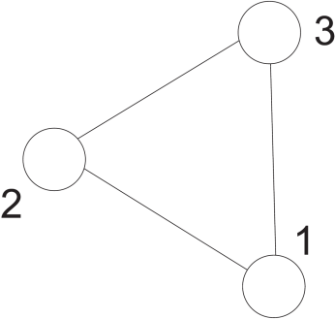
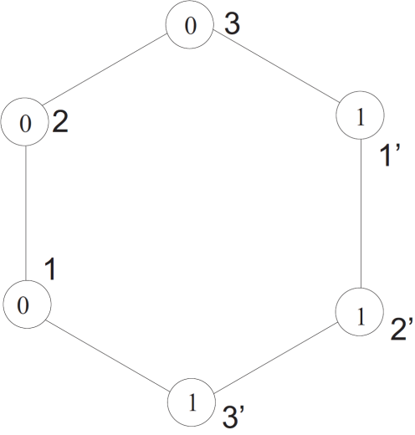
BG – Proof of Impossibility for n=3, m=1
Proof: Indirect approach: Assuming, there is an algorithm solving the problem in a system S:
Construct S’ based on two instances of S with inverse starting values for the second instance

Slide 13
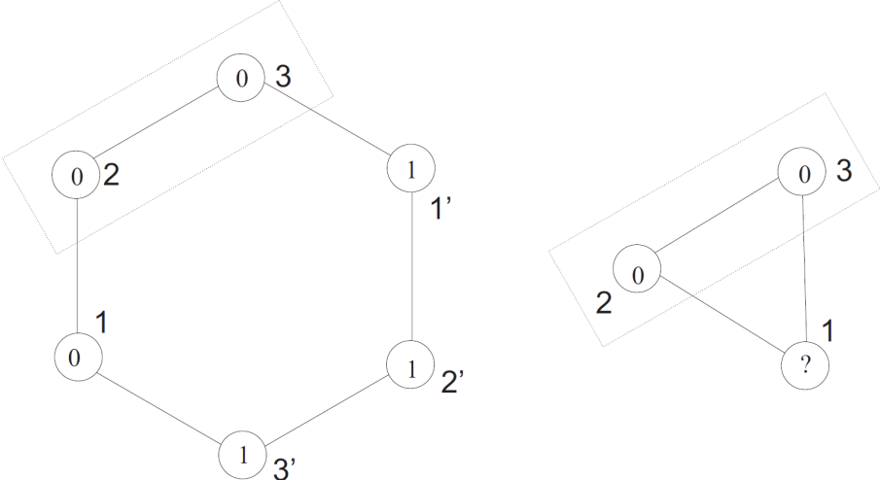
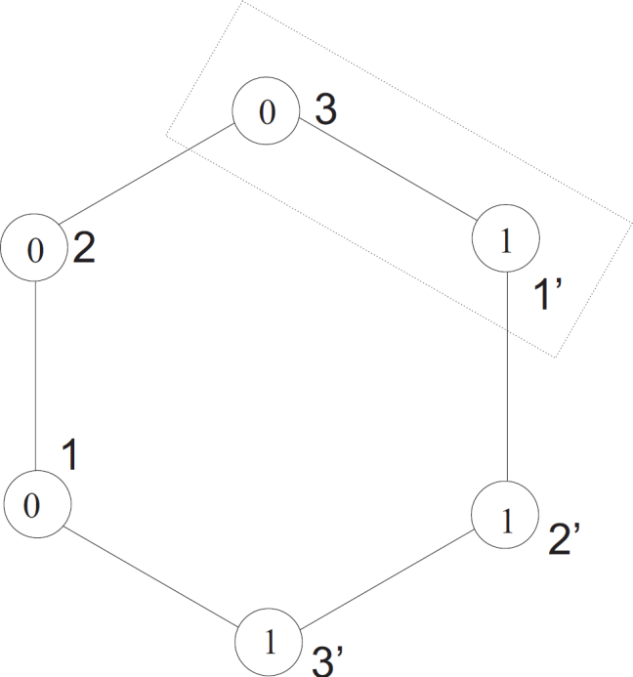
BG – Proof of Impossibility for n=3, m=1
For two nodes, no difference is detectable between S’ and S with a faulty node
Successive application of this argument to pairs of generals leads to a contradiction
For n = 3 and m = 1, no solution is possible!
This result can be generalized: For n ≤ 3m no solution is possible

Slide 14
BG – Algorithm for m = 1
The commander reveals its value to the others (0 or 1)
Then, each general tells each other general the value it received from the commander
Each general makes a majority decision according to the received values
Attention: A faulty commander or general can send what it wants!

Slide 15
Byzantine Generals for n = 4 and m = 1
Most simple case with n ≥ 3m + 1
Case: Commander is faulty
Each general receives {a, a, b} and decides for a
Commander: 0
Lieutenants: 1, 2, 3
0:a
0:b
0:a
1:0:a
2:0:a
It applies a ≠ b !
2:0:a
3:0:b
1:0:a
3:0:b

Slide 16
Byzantine Generals for n = 4 and m = 1
Case: A lieutenant general is faulty
Left general receives {a, a, b} and decides for a
Middle general receives {a, a, b} and decides for a
0:a
0:a
0:a
1:0:a
2:0:a
It applies a ≠ b !
2:0:a
3:0:b
1:0:a
3:0:b

Slide 17
Byzantine Generals
Algorithm can be generalized for larger m through a recursive execution of the algorithm
The algorithm needs m + 1 rounds (that is minimal!)
Unit time complexity m + 1
With m faulty processes, agreement is possible if there are at least 2m + 1 correct processes
It must apply: n ≥ 3m + 1 (The barrier is hard!)
More than 2 / 3 of all processes must work correctly

Slide 18
Recursive algorithm OM for Oral Messages
Initial action at commander: OM(m, 0, {1, …, n - 1}, v)
Initial action at lieutenant L: M_{L}={}
PROC OM(m, C, G, t) {
FOREACH L in G DO
SEND (m, G, C + ":" + t ) TO L;
END
}
{Message (m, G, t) is received by lieutenant L}:
IF (m, G, t) is pending THEN
M_{L} := M_{L} ∪ t;
IF m != 0 THEN
OM(m - 1, L, G \ {L}, t);
FI
FI
{Lieutenant P has received all messages}:
v:=tree_majority(M_{L});
Commander: General 0
Lieutenants: Generals 1 – (n-1)

Slide 19
Recursion Tree for n = 5 and m = 1
0
1. Round
n - 1
1
2
3
4
2. Round
n - 2
2
3
4
1
3
4
1
2
4
1
2
3

Slide 20
Byzantine Generals – Message Complexity
An instance of OM(m) starts (n – 1) instances of OM(m – 1)
Each instance of OM(m – 1) starts (n – 2) instances of OM(m – 2)
Each instance of OM(m – 2) starts (n – 3) instances of OM(m – 3)
…
Each instance of OM(1) starts (n – m) instances of OM(0)
Each instance of OM(m) sends (n – 1) messages
Each instance of OM(m – 1) sends (n – 2) messages
Each instance of OM(m – 2) sends (n – 3) messages
…
Each instance of OM(1) sends (n – m) messages
Each instance of OM(0) sends (n – 1 – m) messages

Slide 21
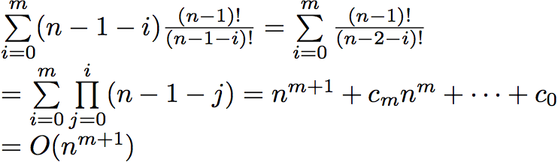
Byzantine Generals – Message Complexity
1. round: 1 instance with n – 1 messages each
2. round: n – 1 instances with n – 2 messages each
3. round: (n – 1)(n – 2) instances with n – 3 messages each
…
(m+1)-th R.: (n – 1)! / (n – 1 – m)! instances with n – 1 – m messages each
Derivation of the message complexity
Assumption: Faulty generals do not send more messages than given by the algorithm.

Slide 22
Byzantine Generals – Message Complexity
n = 4, m = 1
3 + 3 · 2 = 3 + 6 = 9 messages
n = 7, m = 2
6 + 6 · 5 + 6 · 5 · 4 = 156 messages
n = 10, m = 3
9 + 9 · 8 + 9 · 8 · 7 + 9 · 8 · 7 · 6 = 3,609 messages
n = 13, m = 4
13 + 13 · 12 + 13 · 12 · 11 + 13 · 12 · 11 · 10 + 13 · 12 · 11 · 10 · 9 = 108,384 messages

Slide 23
Message Tree/ Tree Majority Function
Each general forms a message tree from the messages it has received
Therefore, it arranges the received messages in accordance to the postfix of their message path
Repeat majority formation, until a single value is derived, after following method
The majority is formed for each node directly above the leafs from its value and the values of the leafs below it
If there is no majority, a (predefined) default value is used

Slide 24
Message Tree for General 1 and n = 7, m = 2
General 5 and 6 faulty, commander sends a to the nodes 1 to 6
In the second round, 5 and 6 send arbitrary values to the others; here b to create maximum confusion
0:a
Postfix 2:0
2:0:a
3:0:a
4:0:a
5:0:b
6:0:b
2:5:0:b
3:2:0:a
2:3:0:a
2:4:0:a
6:5:0:b
2:6:0:b
4:2:0:a
4:3:0:a
3:4:0:a
3:5:0:b
3:6:0:b
5:2:0:b
5:3:0:b
5:4:0:b
4:5:0:b
4:6:0:b
6:2:0:b
6:3:0:b
6:4:0:b
5:6:0:b

Slide 25
Message Tree for General 1 and n = 7, m = 2
0:a
a
a
a
b
b
This figure shows the message tree of the previous
slide after the first majority formation.

Slide 26
Message Tree for General 1 and n = 7, m = 2
a
This figure shows the message tree of the previous
slide after the second majority formation.

Slide 27
Message Tree for General 1 and n = 7, m = 2
Generals 0 (commander) and 6 faulty
Commander sends a to generals 1 to 3 and b to 4 to 6
General 6 sends in 2. + 3. round arbitrary values to the others (x1,x2,x3,x4,x5)
Depending on the values x1 to x5 of general 6, all correct generals agree on a or the default value
0:a
Postfix 2:0
2:0:a
3:0:a
4:0:b
5:0:b
6:0:x1
2:5:0:b
3:2:0:a
2:3:0:a
2:4:0:b
6:5:0:?
2:6:0:x2
4:2:0:a
4:3:0:a
3:4:0:b
3:5:0:b
3:6:0:x3
5:2:0:a
5:3:0:a
5:4:0:b
4:5:0:b
4:6:0:x4
6:2:0:?
6:3:0:?
6:4:0:?
5:6:0:x5

Slide 28
Message Tree for General 4 and n = 7, m = 2
Generals 0 (commander) and 6 faulty
Commander sends a to generals 1 to 3 and b to 4 to 6
General 6 sends in 2. + 3. round arbitrary values to the others (x1,x2,x3,x4,x5)
Depending on the values x1 to x5 of general 6, all correct generals agree on a or the default value
0:b
Postfix 1:0
1:0:a
2:0:a
3:0:a
5:0:b
6:0:x4
1:5:0:b
2:1:0:a
1:2:0:a
1:3:0:a
6:5:0:?
1:6:0:x1
3:1:0:a
3:2:0:a
2:3:0:a
2:5:0:b
2:6:0:x2
5:1:0:a
5:2:0:a
5:3:0:a
3:5:0:b
3:6:0:x3
6:1:0:?
6:2:0:?
6:3:0:?
5:6:0:x5

Slide 29
Byzantine Generals – Signed Messages
If messages can be signed forgery-proof (signed messages), the agreement can be achieved with arbitrarily many faulty processes
Precondition so far: Synchronous system
"In an asynchronous system no agreement is possible."
Fisher et al., 1985
Many other (theoretical) papers with this topic with differing assumptions

Slide 30
Byzantine Generals – Conditions for Solvability
In literature, a number of impossibility proofs for byzantine generals or similar problems was given
Dolev et. Al. identified five system characteristics that are important
Execution at nodes: Synchronous vs. asynchronous
Communication: Synchronous vs. asynchronous
Order of messages: ordered (FIFO) vs. not ordered
Communication scheme: broadcast vs. point to point
Atomicity of send/receive: atomic vs. not atomic

Slide 31
Byzantine Generals – Conditions for Solvability
Exactly four cases were identified for existence of byzantine agreement with f > 1 faulty nodes
Synchronous nodes and synchronous communication
Synchronous nodes and ordered messages
Broadcast and ordered messages
Synchronous communication, broadcast, atomic send/receive
For f = 1 another case exists:
Asynchronous nodes, synchronous communication, point-to-point communication and atomic send/receive

Slide 32
Literature
L. Lamport, R. Shostak, and M. Pease. The Byzantine Generals Problem. ACM Transactions on Programming Languages and Systems, 4(3):382--401, 1982.
D. K. Pradhan: Fault-Tolerant Computer System Design, section 3.4 and chapter 8
N.A. Lynch: Distributed Algorithms, Chapter 6
M. Barborak, M. Malek, A. Dahbura: The Consensus Problem in Fault-Tolerant Computing, ACM Computing Survey Vol 25, Nr. 2, 1993

